Slide 1



Capstone Project Report
“Autonomous Vehicle control System”
M.P.Nachimuthu M.Jaganathan Engineering College
Trainer Name
T.Arun AP/Mech
NM ID | NAME
au731721114001 | Dhanush M

Slide 2

Abstract:
Autonomous vehicle technology has rapidly advanced in recent years, promising safer and more efficient transportation solutions. Central to the successful operation of autonomous vehicles is their ability to perceive and navigate their environment autonomously. Lane detection plays a pivotal role in this process, serving as a fundamental component of autonomous vehicle control systems. This abstract explores the essence of lane detection in autonomous vehicle control systems, highlighting its significance, techniques, and challenges. It discusses various image processing techniques and machine learning approaches employed for accurate lane detection, along with the challenges posed by variability in lighting conditions, road marking variations, and occlusions.

Slide 3
Problem Statement:
Autonomous vehicle technology holds immense promise for revolutionizing transportation by offering safer, more efficient, and convenient means of travel.
Despite significant advancements in image processing and machine learning techniques, challenges such as variability in lighting conditions, road marking variations, and occlusions persist, hindering the robustness and reliability of lane detection algorithms.
Therefore, there is a pressing need to address these challenges and develop innovative solutions to enhance the accuracy, efficiency, and robustness of lane detection in autonomous vehicle control systems.
By doing so, we can accelerate the adoption and deployment of autonomous vehicles, paving the way for safer and more efficient transportation systems in the future.

Slide 4
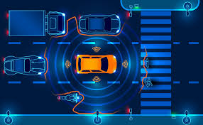
Aim:
The aim of this study is to enhance the accuracy, efficiency, and robustness of lane detection in autonomous vehicle control systems by addressing the challenges posed by variability in lighting conditions, road marking variations, and occlusions.

Slide 5
Objectives:
Investigate state-of-the-art image processing techniques and machine learning algorithms for lane detection in autonomous vehicles.
Analyze the impact of variability in lighting conditions on the performance of lane detection algorithms and develop adaptive solutions to mitigate its effects.
Evaluate the effectiveness of different approaches for handling road marking variations and occlusions in lane detection.
Develop novel algorithms or enhancements to existing methods to improve the accuracy and robustness of lane detection in challenging scenarios.
Implement and validate the proposed solutions through extensive testing and experimentation using real-world datasets and simulation environments.

Slide 6
Proposed System:
Overview:
The proposed system aims to enhance the accuracy, efficiency, and robustness of lane detection in autonomous vehicle control systems. By addressing challenges such as variability in lighting conditions, road marking variations, and occlusions, the system will improve the reliability of lane detection algorithms, thereby enhancing the overall navigation capabilities of autonomous vehicles

Slide 7
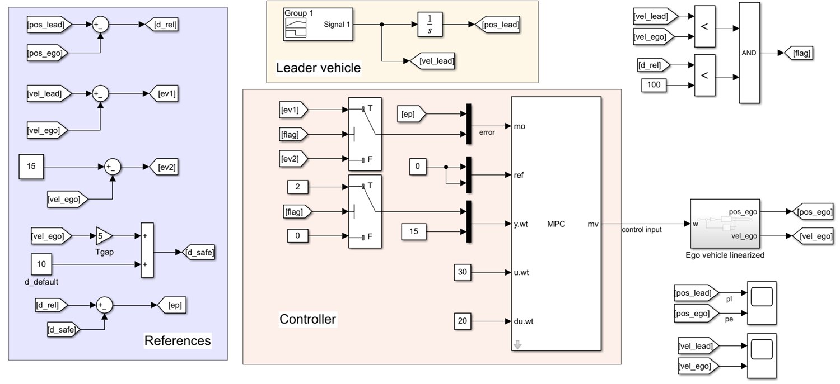
ACC With MPC:2* Case

Slide 8
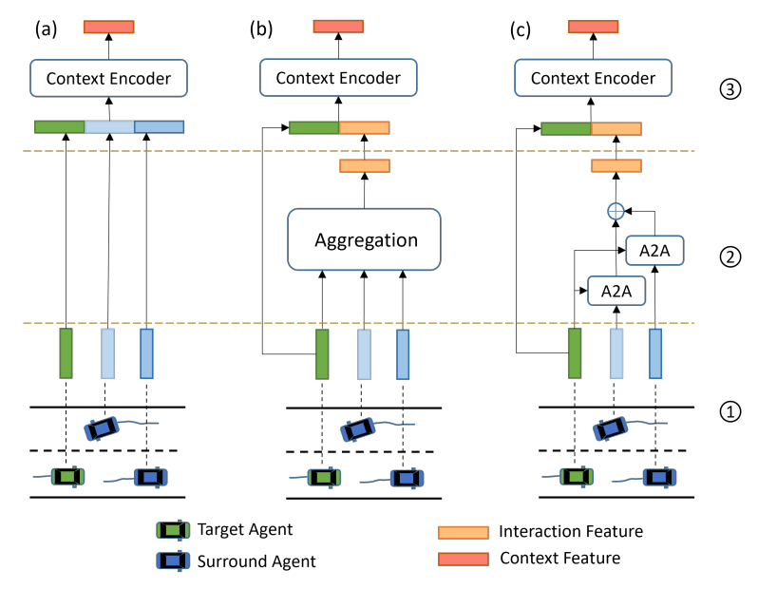
Implicit-Based for Interaction Consideration:

Slide 9
Components:
Multi-Sensor Suite:
Utilize a combination of cameras, LiDAR, and radar sensors to capture comprehensive environmental data.
Integration of sensor data to provide a holistic perception of the vehicle's surroundings.
Adaptive Image Processing Techniques:
Develop adaptive image processing algorithms capable of dynamically adjusting parameters based on varying lighting conditions.
Incorporate techniques such as histogram equalization, adaptive thresholding, and gamma correction to enhance image clarity and contrast.
Advanced Machine Learning Models:
Implement deep learning models, such as Convolutional Neural Networks (CNNs), for feature extraction and lane detection.
Train the models on diverse datasets to improve generalization and robustness in different scenarios.

Slide 10
Benefits:
Improved accuracy and reliability of lane detection in diverse driving conditions.
Enhanced safety and efficiency of autonomous vehicles through more precise navigation.
Increased robustness against challenging scenarios, such as adverse weather conditions and complex road environments.
Facilitation of widespread adoption of autonomous vehicles by addressing key challenges in perception and navigation.

Slide 11
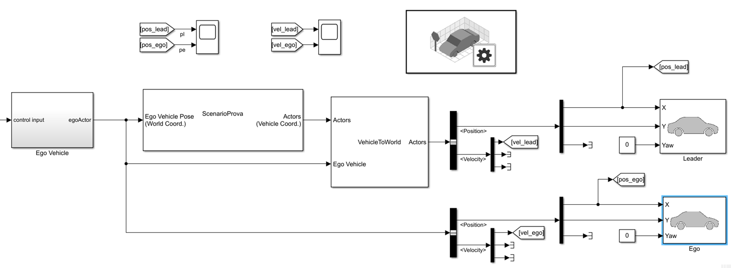



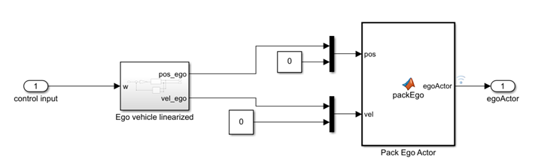
Test with Automated Driving Toolbox:

Slide 12
Requirement Analysis:
Identify the specific requirements and constraints of the target deployment environment, including hardware specifications, operating conditions, and performance metrics.
System Design:
Design a modular and scalable system architecture that accommodates the integration of enhanced lane detection algorithms with existing autonomous vehicle control systems.
Specify the interfaces and communication protocols between different system components to facilitate seamless integration.
Development and Implementation:
Develop the enhanced lane detection algorithms and associated software modules based on the proposed system design.
Utilize industry-standard programming languages (e.g., Python, C++) and frameworks (e.g., OpenCV, TensorFlow) for implementation.

Slide 13
Deployment Planning:
Develop a deployment plan outlining the steps, timeline, and resources required for deploying the enhanced lane detection system in autonomous vehicles.
Consider factors such as software updates, maintenance procedures, and potential impact on vehicle operation during deployment.
Integration
Integrate the enhanced lane detection system with existing autonomous vehicle control systems, ensuring seamless communication and interoperability.
Validate the integration through extensive testing and verification to ensure proper functionality and compatibility.

Slide 14
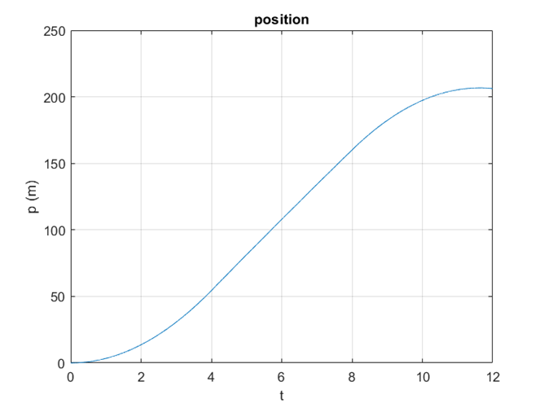
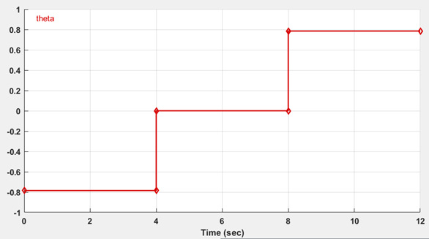
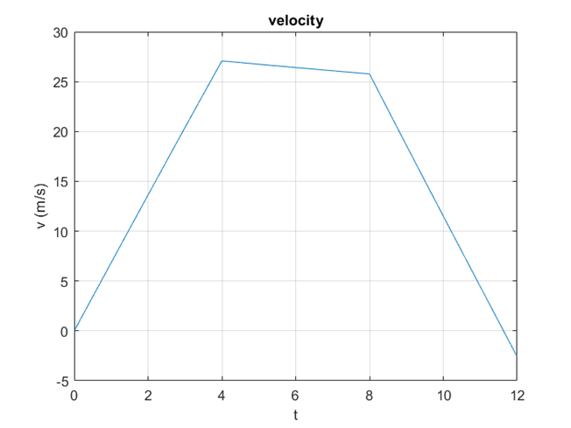
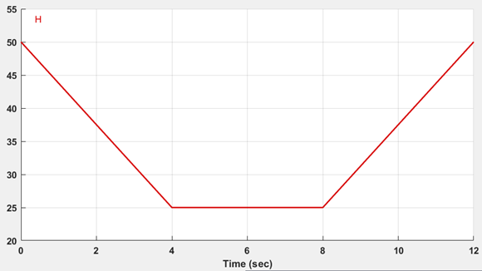
Open loop analysis: zero input and zero initial condition

Slide 15
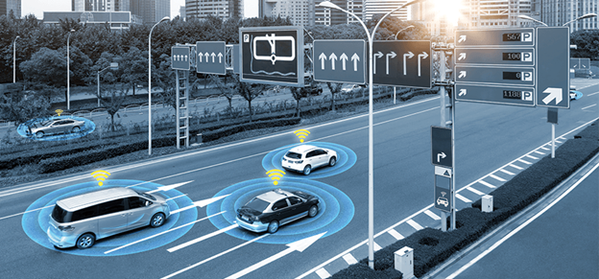
Future Scope :
3D Lane Detection: Explore and develop techniques for 3D lane detection to enhance depth perception and enable more accurate lane tracking, especially in complex road environments
Multi-Sensor Fusion: Enhance lane detection algorithms through the fusion of data from multiple sensors, including cameras, LiDAR, radar, and inertial measurement units (IMUs), to provide a more comprehensive and robust perception of the vehicle's surroundings.
Edge Cases Handling: Address edge cases and rare scenarios that may challenge existing lane detection algorithms, such as unusual road markings, extreme weather conditions, and unconventional road layouts.
Real-Time Decision Making: Integrate lane detection with real-time decision-making systems to enable proactive responses to detected lane deviations, such as autonomous lane keeping and corrective maneuvers.

Slide 16
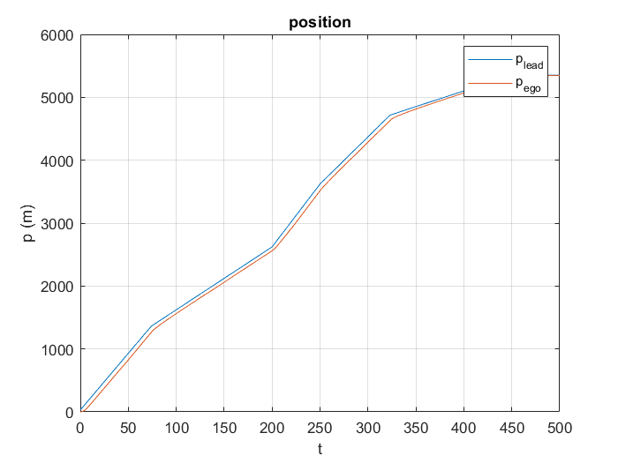
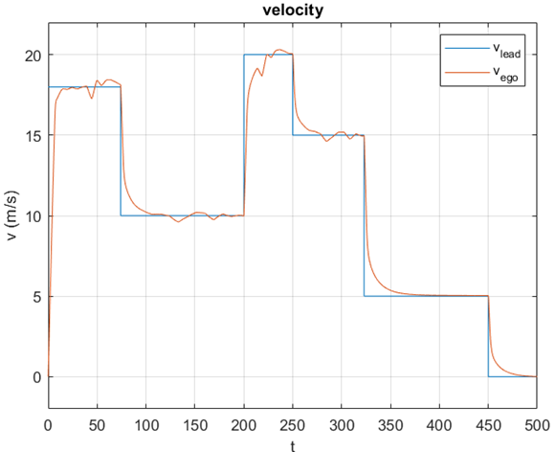
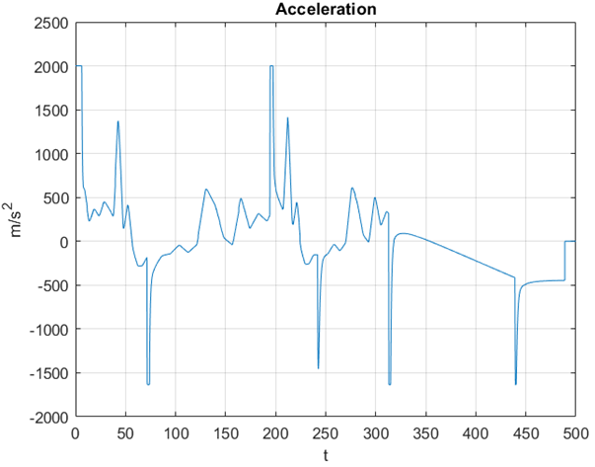
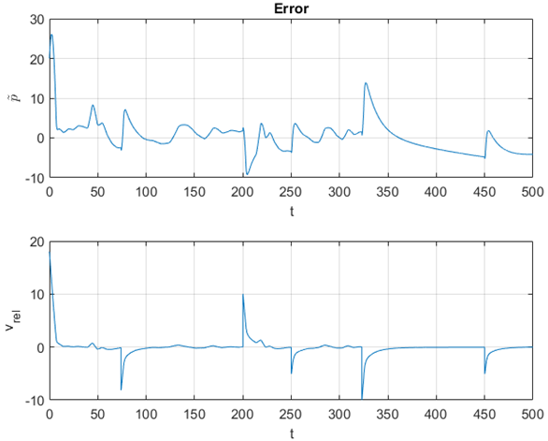
Result:

Slide 17

conclusion:
First of all we have carried on an open loop analysis of the nonlinear model of the ego vehicle
Then we have done a closed loop analysis specifying control requirements and designing different control strategies and considering different cases
After that we’ve validated such controllers exploiting Automated Driving Toolbox, so considering the leader vehicle provided from such toolbox
Finally we have led an analysis about robustness to parameters uncertainty on the controller designed
As future development, an idea could be designing an adaptive model predictive controller because of variation of some parameters, and nonlinear model predictive controller

Slide 18
Reference:
Hussain, R.; Zeadally, S. Autonomous cars: Research results, issues, and future challenges. IEEE Commun. Surv. Tutor. 2018, 21, 1275–1313. [CrossRef]
Alahi, A.; Goel, K.; Ramanathan, V.; Robicquet, A.; Fei-Fei, L.; Savarese, S. Social lstm: Human trajectory prediction in crowded spaces. In Proceedings of the IEEE Conference on Computer Vision and Pattern Recognition, Las Vegas, NV, USA, 26 June–1 July 2016; pp. 961–971.
Gupta, A.; Johnson, J.; Fei-Fei, L.; Savarese, S.; Alahi, A. Social gan: Socially acceptable trajectories with generative adversarial networks. In Proceedings of the IEEE Conference on Computer Vision and Pattern Recognition, Salt Lake City, UT, USA, 18–22 June 2018; pp. 2255–2264.
Xue, H.; Huynh, D.Q.; Reynolds, M. Bi-prediction: Pedestrian trajectory prediction based on bidirectional LSTM classification. In Proceedings of the 2017 International Conference on Digital Image Computing: Techniques and Applications (DICTA), Sydney, Australia, 29 November–1 December 2017; pp. 1–8.
Zhang, P.; Ouyang, W.; Zhang, P.; Xue, J.; Zheng, N. Sr-lstm: State refinement for lstm towards pedestrian trajectory prediction. In Proceedings of the IEEE/CVF Conference on Computer Vision and Pattern Recognition, Long Beach, CA, USA, 16–20 June 2019; pp. 12085–12094.

